Slide 1
Five Project Management Process Groups
Christopher Paez, Chang Woo Shin, Israa Jeddeeni,

Slide 2
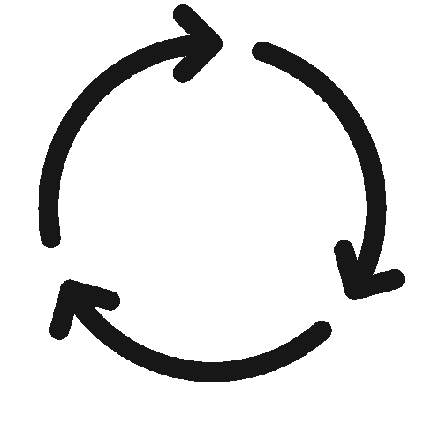
Project Life Cycle
Complex projects that are far-reaching in scope, resource-heavy, and are high in strategic importance will require higher levels of project management knowledge. Having a basic understanding of the project life cycle and the 5 phases of project management will help project managers achieve consistent and repeatable project success.

Slide 3
What is the project life cycle?
The project life cycle includes the steps required for project managers to successfully manage a project from start to finish. There are 5 phases to the project life cycle (also called the 5 process groups). Each of these project phases represents a group of interrelated processes that must take place.

Slide 4
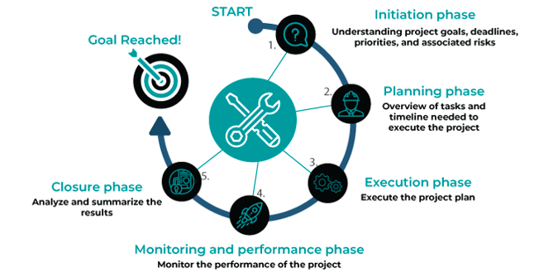
The 5 process groups of project management

Slide 5
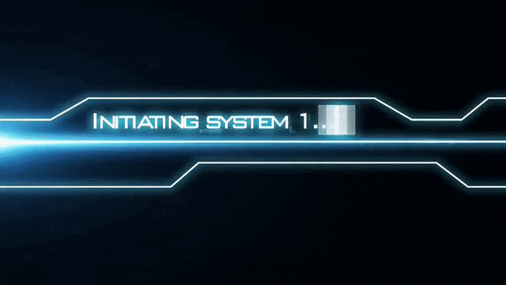
Initiating
The initiating phase of the project life cycle consists of just two separate processes: the project charter and stakeholder register.
The point of this phase is to determine the vision for your project, document what you hope to accomplish, and secure approvals from a sanctioning stakeholder.

Slide 6
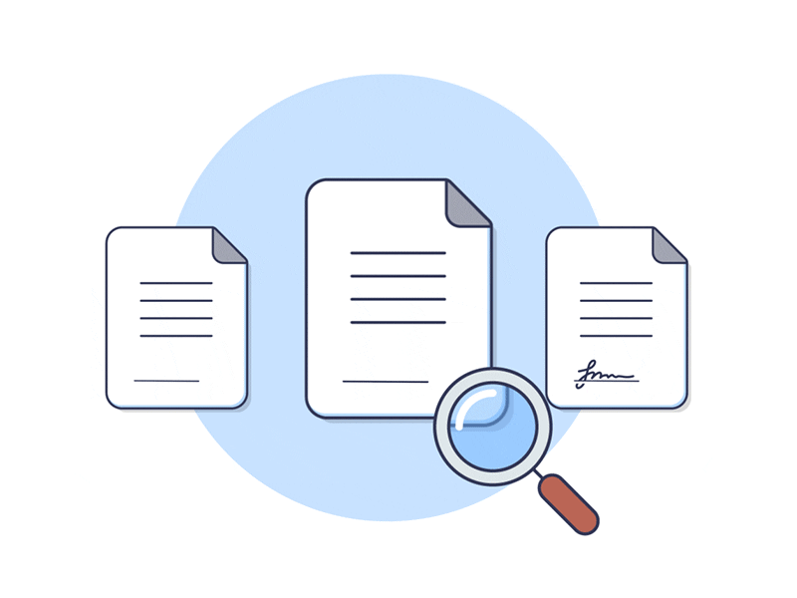

What is a project charter?
A project charter is a short, straightforward document that serves as the foundation for a project.
The project charter functions as both the project’s internal marketing tool and reference guide.

Slide 7
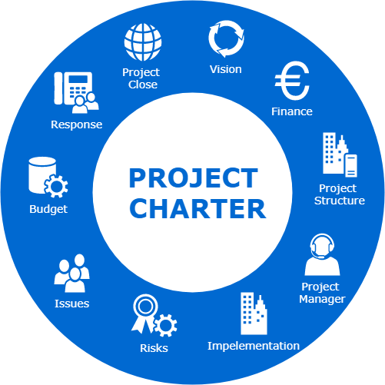
What’s included in a project charter?
Business case
Project scope
Deliverables
Objectives
Resources needed
Milestone plan and timeline
Cost estimate
Risks and issues
Dependencies

Slide 8

What is a Stakeholder Register?
A stakeholder register is a project document with pertinent information about the project stakeholders.
It identifies the people, groups, and organizations that have any interest in the project or its outcome.

Slide 9
A stakeholder register can have the following information of stakeholders:
Names | Titles | Roles | Interests | Power | Requirements | •Expectations | •Type of influence

Slide 10

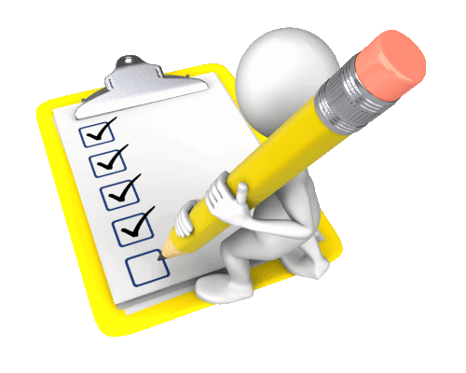
Planning
Establishing the project's overall scope is an important part of the planning process.
While it may appear that scope (together with risks, milestones, summary, and budget) was specified at a high level in Initiating, it was not.
the planning phase process group is where you build the project infrastructure that will enable you to achieve your goal within your predetermined time and budget constraints.
The planning stage includes; starting with a project management plan, project scope, work breakdown structure and more—and wrapping up with qualitative and quantitative risk analyses and risk responses.

Slide 11
Executing
Where the work get done and mostly this process takes the most resources to perform the process.
Project Manager lead the team.
Project Manager will utilize leadership skill during executing phase and execute plans to guide the team.
The team might encounter hardships and challenges along the way of the executing phase, and Project Manager will handle these situations.
Project Manager will not only desire the outcome in the execution phase, but also the project manager will also perform team-building exercise to develop the team.

Slide 12

Executing cont.
The team will not just perform/execute the project; through this phase the team will develop to be a better team.
As the team execute the project, it will motivate the team and lead to successful executing phase.
Most of the resources will be used in this executing phase including time.

Slide 13

Executing cont.
Some project stakeholders might ask team to change or modify the project due to all the resources that has been spent, and that is when the Control Board of the project steps in.
Control Board will be the acting bridge between the team, who is executing the project, and project stakeholders.
Control Board will resolve any conflicts that might happen along the project execution.
Control Board will be the only one to determine whether to accept the changes or modification request, or they can also decline.

Slide 14
Monitoring/ Controlling
The main goal of the project is to monitor all the progresses and control the team to perform better.
The project manager will assess the overall performance and duration of the project.
Project Manager will make any necessary minor changes to keep the project on track.
Not any major changes will be made, if so, it will be reported back to project stakeholders and project control board.
Goes hands on hands with execution phase.

Slide 15

Monitoring/ Controlling cont.
Timeline can be modified in this phase as well; it can be extended to bring better result for the project, or it can be shortened when the project output is very successful.
The team has to constantly monitor themselves with new timeline, if any changes were made.

Slide 16
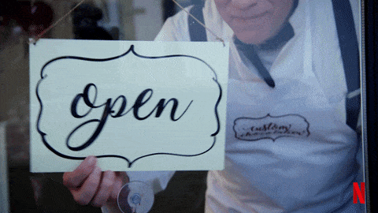
Closing
The team will be closing the project and be ready to be finalized.
This phase will be the key phase to determine the success rate of the project outcome.
Success rate can be determined by customer review or survey. Analyzed by all the stakeholders.
This phase is not where the team will make any changes, it should have been completed through execution phase.
The team will provide positive and negative feedback toward the project.
These feedbacks will perform as the new guideline for the next or upcoming project.
All the past phases will be valuable lesson for all the team members.
The project manager will officially sign and close the project, releasing the team.

Slide 17

Five Project Management Process Groups, Conclusion
These were the Five Project Management Process Groups.
These five process groups will perform as the main guideline to lead the team toward successful project.
Our group also followed this guideline to complete the group project.

Slide 18
References:
Adobe Experience Cloud. (2021). Project Life cycle. Project Life Cycle - The 5 Process Groups | Adobe Workfront. Retrieved December 2, 2021, from https://www.workfront.com/project-management/life-cycle.
Usmani, F. (2021, August 23). Stakeholder Register in project management. PM Study Circle. Retrieved December 2, 2021, from https://pmstudycircle.com/stakeholder-register-project-management/.
Project Management Academy. “The Five Traditional Process Groups Explained.” Project Management Academy, 15 Sept. 2021, projectmanagementacademy.net/articles/five-traditional-process-groups/.
Project Management Institute, A Guide to the Project Management Body of Knowledge (PMBOK® Guide) - Sixth Edition, Project Management Institute Inc., 2017, Page 23.

